Slide 1
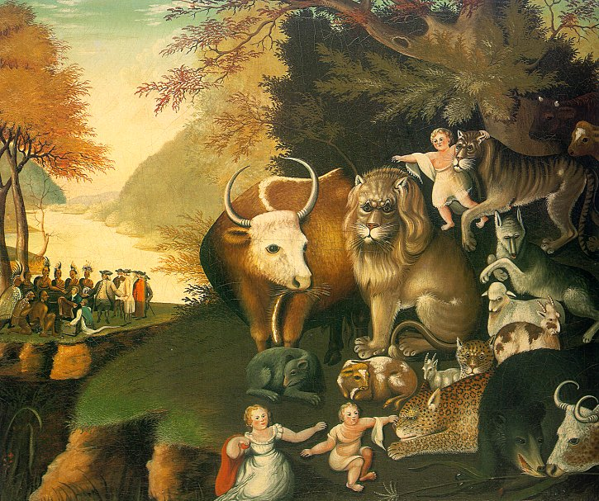
The Book of Isaiah
A mini-Bible
St. Mina Coptic Orthodox Church
Hamilton, ON

Slide 2
The Prophet Isaiah
A prophet in the 8th century BC; in the Kingdom of Judah
His name means “God is salvation”
An evangelical prophet
According to Jewish tradition, born to an aristocratic “royal” family in Jerusalem
His father being the brother to king Uzziah
Ministered in Jerusalem during the reign of Uzziah, Jotham, Ahaz, Hezekiah
Sawed in half according to tradition
A contemporary with Micah, Amos, Hosea

Slide 3
The Prophet Isaiah
Appeared at a critical time in Judah’s history, 8th century BC
He proclaimed a message of judgment and demanded repentance!
As Isaiah was beginning his ministry, the Assyrians were in the process of building an empire that threatened to swallow up Israel unless God intervened.

Slide 4
Timeline for Isaiah
~50 years
~100 years after Isaiah
739 BC
690 BC
Period of Isaiah’s Prophecies -- The “Days
of Uzziah, Jotham, Ahaz, and Hezekiah”
606, 597, 586 BC: Judah Conquered
0 BC/AD
537 BC: Cyrus Conquers Babylon; the Return Begins
300-200 BC: Septuagint Written
30-33 AD: Messiah Comes
~720 years After Isaiah (& 280 years after Septuagint)
~170 years After Isaiah

Slide 5
Historical Setting
He had to choose between placing his trust in human wisdom and power or in God to deliver the nation from war.
The outcome was Judah’s loss of political independence.
People were lethargic and idolatrous; They were spiritually insensitive (1:3-6).
“The ox knows his master, the donkey his owner’s manger, but Israel does not know, my people do not understand.”
(Isaiah 1:3)

Slide 6
Historical Setting
Israel was falling down (722 B.C.)
Judah was in a downward spiral both politically and spiritually
Uzziah (790-739) – good but proud
Jotham (750-731) – good but weak
Ahaz (735-715) - bad
Hezikiah (715-686) - good
The war between Assyria and the allies
Assyria’s increasing threat to Judah

Slide 7
Spiritual Setting
  People were spiritually insensitive (1:3-6) “ The ox knows his master, the donkey his owner’s manger, but Israel does not know, my people do not understand. “(Isaiah 1:3)
  They suffered malnutrition of the spirit “Stop bringing meaningless offerings! Your incense is detestable to me. New Moons, Sabbaths and convocations—I cannot bear your evil assemblies.” (Isaiah 1:13)
  They had lost perspective (1:21-23) “ See how the faithful city has become a harlot! She once was full of justice; righteousness used to dwell in her— but now murderers! “

Slide 8
Spiritual Setting
  Isaiah was called to a huge mission!
  But before Isaiah walks into this mess, God appears to him in chapter 6 to prepare him
  The problem is that people had attributed too much humanity to God.
  God was trivialized, secularized and rationalized.
  What Isaiah seen in the vision (chapter 6) would contradict their perceptions of God
  God has retinue – “Seraphim” (burning ones) no earthly reality could cope with the reality of God

Slide 9
Spiritual Setting
  God Dwells in Another Dimension: “² Above him were seraphs, each with six wings: With two wings they covered their faces, with two they covered their feet, and with two they were flying.” (Isaiah 6:2)
  “Woe is me! for I am undone (ruined), because I am a man of unclean lips, and I dwell in the midst of a people of unclean lips: for mine eyes have seen the King, the LORD of hosts.
The Prophet’s Absolution– sin purged(6:6-7) one of the seraphim came to Isaiah in his deep despair to provide help/hope; with a live coal from the altar ; with his sin removed, Isaiah now able to stand in the presence of God
How should this scene affect the way we look at God and the way we should praise Him?

Slide 10
Outline (A)
Words of Judgment (1-39)
- The sins of Israel and Judah (1-9)
- Immanuel (7-12)
- Judgment on the nations (13-23)
- Judgment on Judah and deliverance (24-27)
- Woes upon Israel and promise (28-35)
- Invasion of Assyria & Hezekiah (36-39)

Slide 11
Outline (B)
Words of Comfort (40-66)
- Israel’s deliverance from captivity (40-48)
- The servant of the Lord (49-57)
- Restoration of Israel and the final kingdom (58-66)
- Forgiveness, comfort, and hope
- Looks forward to the coming of the Messiah
- Purpose:
To call Judah back to God and to tell of God’s salvation through the Messiah

Slide 12
Features of the book of Isaiah
Isaiah’s apocalypse
Quoted at least 50 times in the NT
Predictions of future events: Israel’s captivity (39:7)
The end of death (25:8) & the resurrection of the dead (26:19)
A great number of prophecies of the Messiah
Called a miniature Bible (66 chapters = 39 + 27)
  Deliverance from sin (1)
  Through Christ (53)
  Restoration of the whole world (65,66)

Slide 13
The Messiah in Isaiah
Isaiah’s portrays of Christ
  The branch of Jesses, Redeemer, Savior, Sin bearer, Liberator, Judge, etc
Names of Christ
  Emmanuel, Might God, Counselor, Prince of Peace, King, Divine Servant, Arm of the Lord, Preacher, The servant of the Lord, The suffering and glory of the Servant
Details of Christ:
- His divine nature, birth, humanity, ministry, and redemptive work, and suffering and glory

Slide 14
Prophecies of Christ

Slide 15
Themes
Salvation
  “Isaiah” means “Salvation is of Yahweh”
  The term “salvation” occurs 27 times
  Salvation is bestowed only by grace and by the power of God, the Redeemer
  Salvation through the Messiah
  Political salvation → Personal & international salvation → Salvation of the whole world
The kingdom of God coming & For the glory of God
The same theme as that of the whole Bible

Slide 16
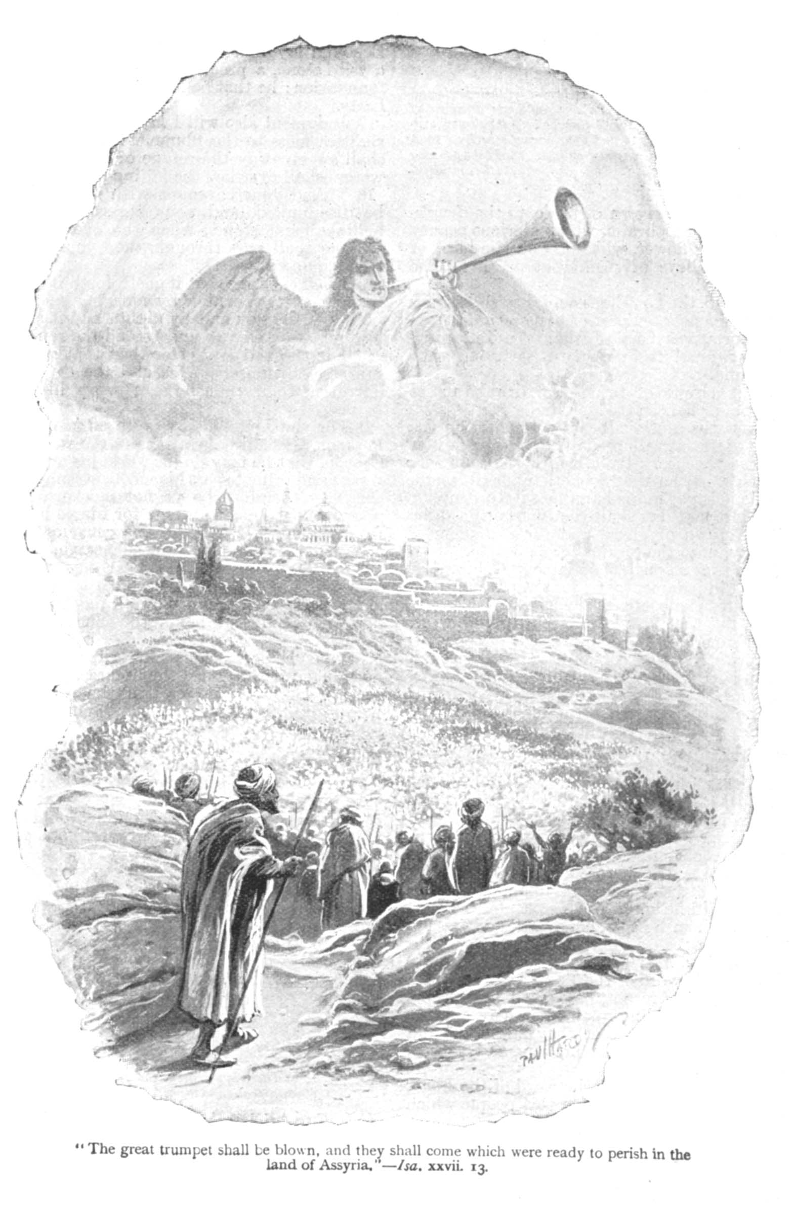
God in Isaiah
Holy One of Israel (28 times)
The God of Hope - remnants
Redeemer (13 times)
God of all nations
God of unfailing love

Slide 17
Chapter 6 - Contemplation
The Call of Isaiah
  Isaiah’s recognition of the majesty of God and his resulting humility
  Isaiah’s acknowledgement of his sin and his resulting hopelessness
  Isaiah’s purification provided by God
  Isaiah’s willingness to do God’s work now that he is purified
The Call of Isaiah Me
  Isaiah’s My recognition of the majesty of God and his my resulting humility
  Isaiah’s My acknowledgement of his my sin and his my resulting hopelessness
  Isaiah’s My purification provided by God
  Isaiah’s My willingness to do God’s work now that he is I am purified

Slide 18
Lessons from the book of Isaiah
Sin and wickedness always bring God’s disfavor
God is holy & loving
God wants his people to put their trust in Him, not in anyone or in anything else
God’s zeal and aspiration for salvation
Isaiah’s entire family dedicated to the service of the Lord

Slide 19
Q & A

