Slide 1
The Christian and Psychological Health

Slide 2
Contents
I. About Psychological Health
II. Harmony of Psychological Functions
III. Psychological Needs
IV. Maslow's Hierarchy of Needs
V. He Meets our Various Psychological Needs

Slide 3
I. About Psychological Health
1. What is ‘Psychology’?
It is the science of the mind or of mental states and processes.
2. Significance of Psychological Health:
- Psychological health is important with respect to how we function and adapt, and with respect to whether our lives are satisfying and productive.
- In the end, psychological health and well-being basically has to do with the question: ‘how are you doing?’

Slide 4
I. About Psychological Health
3. Upside and Downside of Psychological Health:
While this question, ‘how are you doing?’, capture the essence of psychological health, psychologists have found that it actually involves two separate issues. There is an upside and a downside, both of which need to be considered:
a) The Upside:
- The upside involves two factors: is your mood generally positive, and do you enjoy a number of ‘positive emotional ties.’
- In addition to feelings of emotional satisfaction, a positive mood also depends on whether or not you generally feel calm and peaceful.

Slide 5
I. About Psychological Health
b) The Downside:
On the downside, emotional well-being involves three factors: do you suffer anxiety, are you depressed, and do you feel like you have lost control and can't do anything about your feelings. This is the experience of psychological distress.
4. Two Sides of the Coin:
It can usually be said that distress and happiness are two sides of the same coin. Usually, people are either happy or they're not, and if their mood isn't good, they are often distressed to some extent.

Slide 6
I. About Psychological Health
5. Is Psychological Distress Considered a Mental Disorder?
- No. It is important to know that psychological health is an issue quite different from mental or emotional disorder.
- If you are feeling distressed, that doesn't necessarily mean that you are mentally ill.
6. Psychological Health and Life Challenges:
- Ordinary life often presents the individual with extraordinary challenges, complexities, setbacks and hardships. Psychological health concerns itself with how you cope, how you are doing in response, and whether you find life to be interesting and enjoyable.

Slide 7
I. About Psychological Health
- Although life is better when we are feeling good, there is no avoiding the fact that there will be ups and downs.

Slide 8
II. Harmony of Psychological Functions
1. Psychological Health Implies Inner Harmony:
- Psychological health implies the complete harmony and integration among psychological functions leading to a positive feeling of happiness. The meaning of harmony is the absence of inner conflict within a person and the presence of principles governing his life (religious, social, moral). These principles provide a way out of the conflicts.
- Being unable to resolve these conflicts properly leads to tension, anxiety, and loss of self-confidence.

Slide 9
II. Harmony of Psychological Functions
2. Christianity and Personality:
- Christianity gives sufficient and fulfilling remuneration to the personality.
- This is true as the grace of Christ compensates for all deficiencies in man:
“And He said to me: My grace is sufficient for you, for My strength is made perfect in weakness. Therefore most gladly I will rather boast in my infirmities, that the power of Christ may rest upon me” (1 Corinthians 12:9)
- Man possesses extraordinary power through Christ and through the salvation and redemption that has been granted to him in the New Testament.

Slide 10
III. Psychological Needs
1. What are Psychological Needs?
Psychological needs are the innate and universal needs, that must be satisfied for people to develop and function in healthy or optimal ways.
2. They Include:
compassion, attention, strength, trust, self-esteem, and companionship.

Slide 11
IV. Maslow's Hierarchy of Needs
1. What is Maslow’s Hierarchy of Needs?
Maslow's hierarchy of needs is a theory in psychology proposed by Abraham Maslow in his 1943 paper ‘A Theory of Human Motivation’
2. The Pyramid:
- Maslow's hierarchy of needs is often portrayed in the shape of a pyramid with the largest, most fundamental levels of needs at the bottom and the need for self-actualization at the top.
- While the pyramid has become the de facto way to represent the hierarchy, Maslow himself never used a pyramid to describe these levels in any of his writings on the subject.

Slide 12
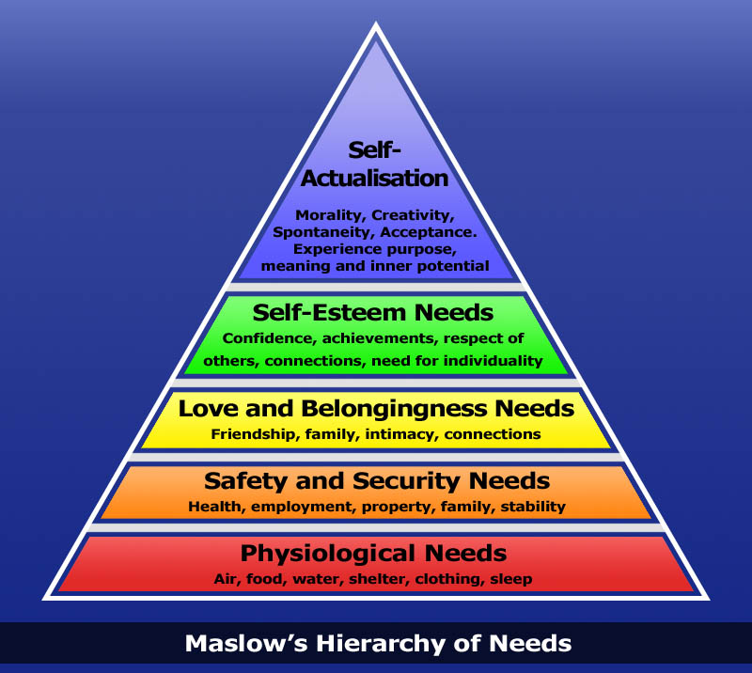
IV. Maslow's Hierarchy of Needs

Slide 13
IV. Maslow's Hierarchy of Needs
3. The Deficiency Needs:
- The most fundamental and basic four layers of the pyramid contain what Maslow called ‘deficiency needs’: esteem, friendship and love, security, and physical needs.
- If these ‘deficiency needs’ are not met – with the exception of the most fundamental (physiological) needs – there may not be a physical indication, but the individual will feel anxious and tense.

Slide 14
IV. Maslow's Hierarchy of Needs
4. Metamotivation:
Maslow's theory suggests that the most basic level of needs must be met before the individual will strongly desire (or focus motivation upon) the secondary or higher level needs. Maslow also coined the term ‘Metamotivation’ to describe the motivation of people who go beyond the scope of the basic needs and strive for constant betterment.
5. Psychological Knowledge and Pastoral Care:
- Unmet psychological needs could be the reason behind many abnormal behaviors some people may show. Therefore, we should consider these needs, while we provide them with spiritual care.

Slide 15
V. He Meets our Various Psychological Needs
1. Our Lord Jesus Christ is Our Satisfaction:
“For My people have committed two evils: They have forsaken Me, the fountain of living waters, and hewn themselves cisterns—broken cisterns that can hold no water” (Jeremiah 2:13)
“Jesus answered and said to her: Whoever drinks of this water will thirst again, but whoever drinks of the water that I shall give him will never thirst. But the water that I shall give him will become in him a fountain of water springing up into everlasting life” (John 4:13)

Slide 16
V. He Meets our Various Psychological Needs
2. He Provides All Our Needs:
a. The Need For Security:
- Christianity fills the souls with security and safety to an extent that is beyond the mind’s conception:
“And the peace of God, which surpasses all understanding, will guard your hearts and minds through Christ Jesus” (Philippians 4:7)
- This is due to the peace God grants to the soul thus shielding it from the penetration of anxieties or pain:

Slide 17
V. He Meets our Various Psychological Needs
“Be anxious for nothing, but in everything by prayer and supplication, with thanksgiving, let your requests be made known to God” (Philippians 4:6)
“And do not seek what you should eat or what you should drink, nor have an anxious mind” (Luke 12:29)
- We trust in God, who is: Almighty, has all the wisdom and loves us, working all things for our good:
“And we know that all things work together for good to those who love God” (Romans 8:28)

Slide 18
V. He Meets our Various Psychological Needs
b. The Need For Love And Tenderness:
- Spiritual life fulfills the need for love: for God is love and love is one of the fruits of the Holy Spirit.
- What characterizes God’s love towards us?
+ It is ultimate and infinite.
+ Continuous and never changes.
+ Not depending on what I am or what I do.
- And when God dwells in one’s heart, He fills it with love for others who would spontaneously love him in return.

Slide 19
V. He Meets our Various Psychological Needs
c. The Need For Appreciation:
- A person grows with the need for others to appreciate him.
- A child deprived of being appreciated grows with weak self-confidence. He dreads new situations, and expects failure in any task he sets out to do.
- For the children of God the need for appreciation is fulfilled on the divine level:
“Then God saw everything that He had made, and indeed it was very good” (Genesis 1:31)

Slide 20
V. He Meets our Various Psychological Needs
“You are all fair, my love, and there is no spot in you” (Song of Solomon 4:7)
- Hence, it does not matter if that need is or is not satisfied socially. The true Christian finds that the most honorable thing is to be considered the child of God and the heir of His kingdom.
- The Christian, consequently, disregards external appearance be it of position, status or authority. Although these are useful and could be exploited by God’s help, yet they do not fulfill the need of the soul for appreciation, since the Holy Spirit already inhabits it and satisfies all its needs.

Slide 21
V. He Meets our Various Psychological Needs
d. The Need For Freedom:
- Freedom is an important psychological need that plays an essential role in the edification of a wholesome personality. There is the condition, however, that such freedom should be within a correct framework:
“For you, brethren, have been called to liberty; only do not use liberty as an opportunity for the flesh, but through love serve one another” (Galatians 5:13)
- God created man as a free being in His image. Hence, youth who call for freedom, express an internal yearning implanted by God Himself within each person.

Slide 22
V. He Meets our Various Psychological Needs
- The Lord Christ also clarified that there is an inner freedom, which He grants:
“If you abide in My word, you are My disciples indeed. And you shall know the truth, and the truth shall make you free” (John 8:31-32)
“Therefore if the Son makes you free, you shall be free indeed” (John 8:36)
- Here comes the question: ‘Freedom from what?’
i) Sin (Inward Matter):
- By committing sin, one is enslaved to it:

Slide 23
V. He Meets our Various Psychological Needs
“Most assuredly, I say to you, whoever commits sin is a slave of sin” (John 8:34)
+ Therefore, sin restrains one’s freedom and hence makes him unhappy.
- We ought then to crucify the body of sin:
“Knowing this, that our old man was crucified with Him, that the body of sin might be done away with, that we should no longer be slaves of sin. For he who has died has been freed from sin” (Romans 6:6-7)
- We use our freedom and opt to resist against sin:

Slide 24
V. He Meets our Various Psychological Needs
“You have not yet resisted to bloodshed, striving against sin” (Hebrews 12:4)
ii) External Influences:
- Like what?
Satan, the world, people and different prevailing thoughts.
- A spiritually oriented person experiences in his life, in sublime ways, how the Lord has liberated us from such influences.
- We also observe this in the lives of the saints:

Slide 25
V. He Meets our Various Psychological Needs
‘I have come to live above the world when I no longer fear things, or lust for anything’ [St. Augustine]

